Slide 1
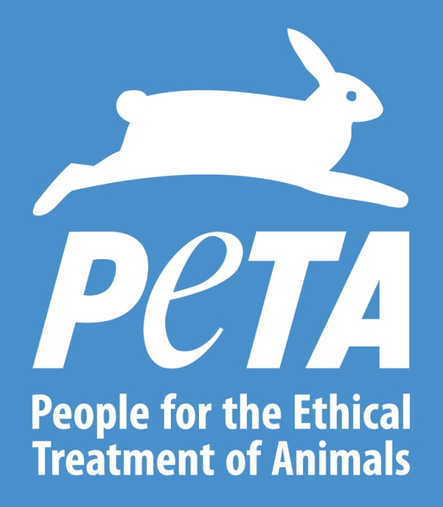
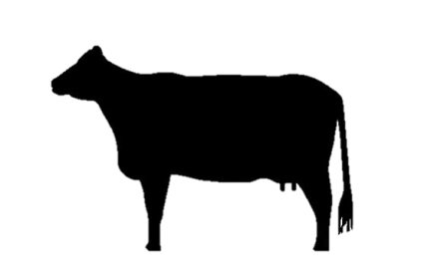
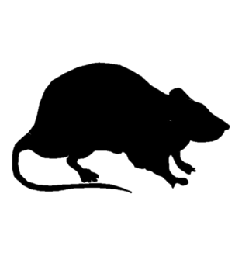
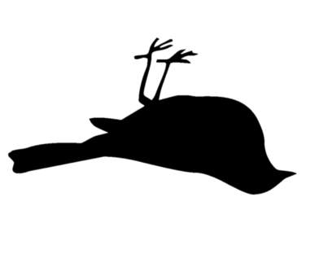
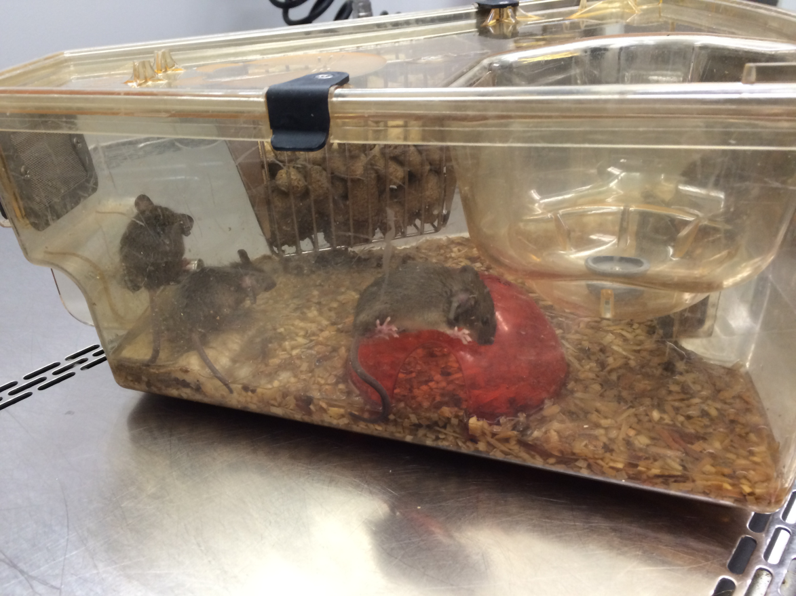
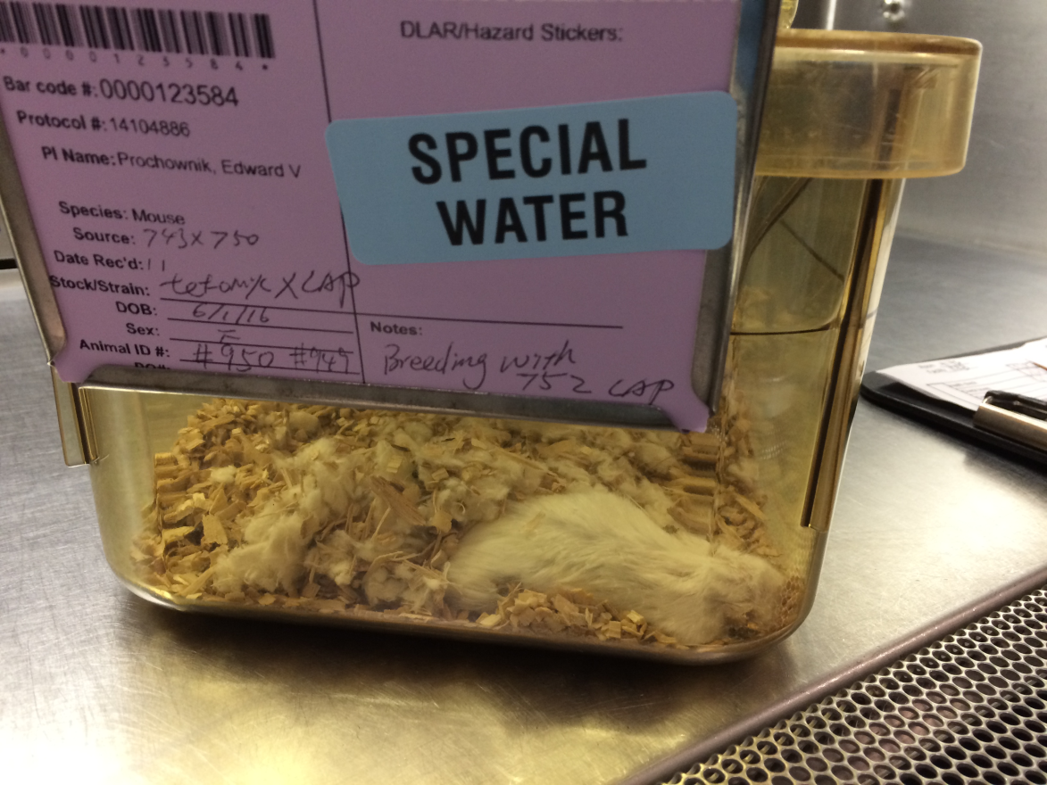
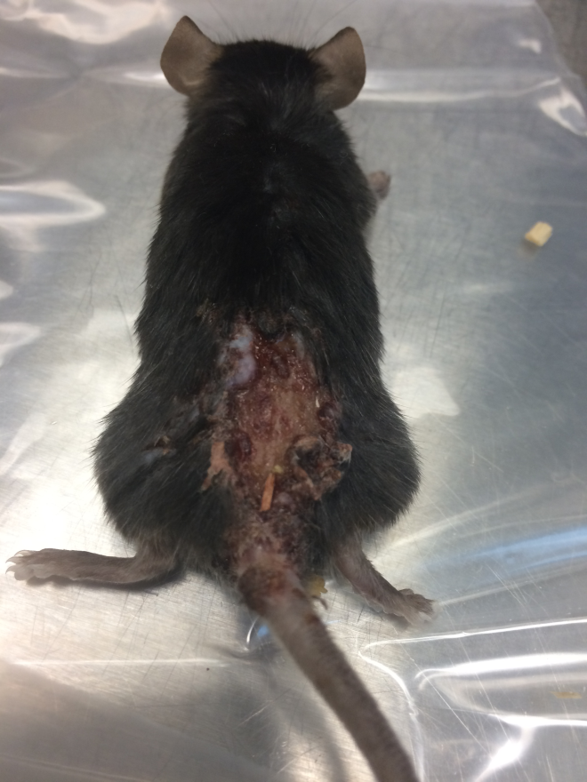
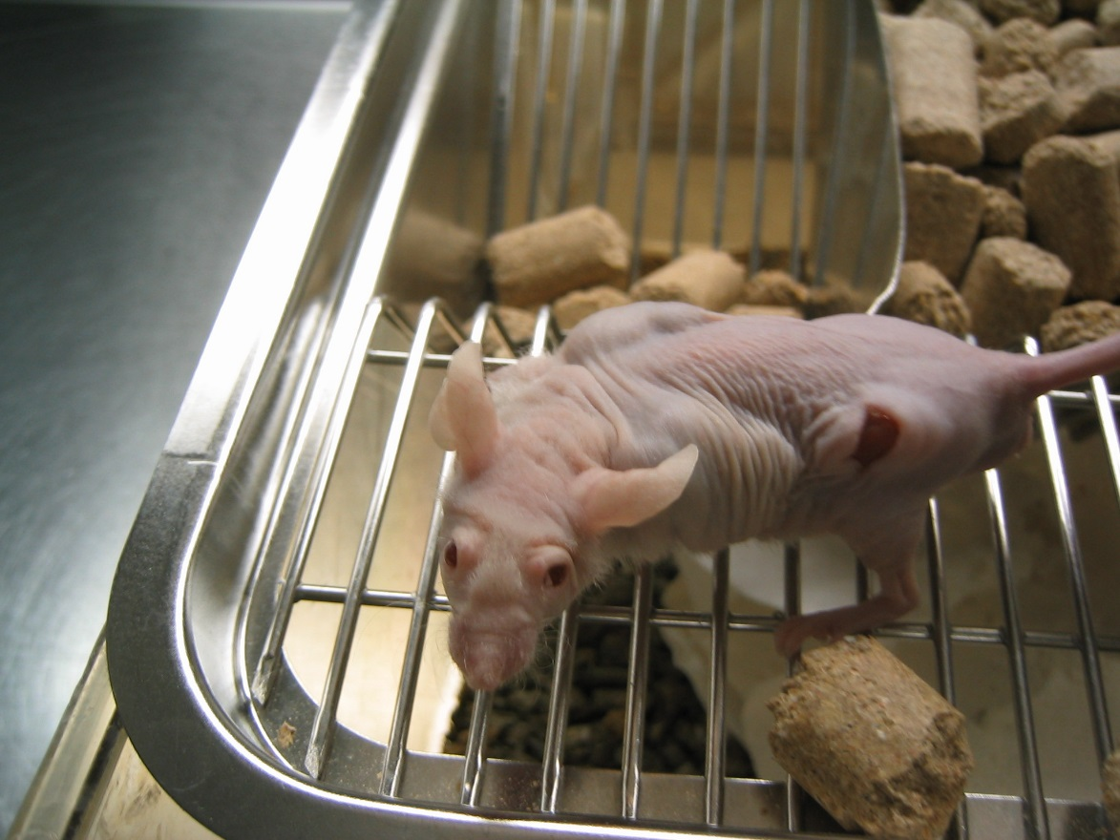
Some Animals are More Equal than Others: Implications of the Exclusion of Mice and Rats from the U.S. Animal Welfare Act
Frances Cheng, Ph.D.¹; Alka Chandna, Ph.D.¹
¹People for the Ethical Treatment of Animals, Norfolk, VA, USA
INTRODUCTION
TOP 20 NIH GRANTEES IN FY 2016
TOP FIVE OFFENDERS
In the U.S., mice of the genus Mus and rats of the genus Rattus are excluded from the Animal Welfare Act (AWA), the single federal law with legally enforceable regulations stipulating basic standards of care for animals. However, institutions that receive federal funding from the National Institutes of Health (NIH) must comply with federal animal welfare guidelines in their treatment of all vertebrate animals.
Does the exclusion from the AWA of mice and rats—who make up the majority of animals used in U.S. laboratories—impact their welfare?
Through Freedom of Information Act (FOIA) requests, we obtained copies of violations reports submitted to the NIH by the top 20 institutional recipients of NIH grants. For the period from January 1, 2015, to April 1, 2017, these reports documented 430 violations of federal animal welfare guidelines related to the treatment of mice and rats—including incidents in which they suffered pain, injury, and death as a result of neglect, incompetence, and disregard.
Funding ranking | Name of Institution | Funding (millions) | Number of reported violations involving mice & rats | Percentage incidents where numbers of mice & rats affected was not reported
1 | Johns Hopkins University | $482 | 0 | NA
2 | University of California, San Francisco | $423 | 22 | 72.7%
3 | University of Michigan | $386 | 52 | 43.5%
4 | University of Pittsburgh | $363 | 53 | 31.9%
5 | University of Pennsylvania | $352 | 8 | 0%*
6 | Stanford University | $324 | 2 | 0%*
7 | Yale University | $314 | 39 | 9.09%
8 | Columbia University Health Sciences | $304 | 7 | 42.9%
9 | University of California, San Diego | $302 | 7 | 75.0%
10 | University of North Carolina, Chapel Hill | $301 | 34 | 54.2%
11 | Washington University | $296 | 8 | 83.3%
12 | Duke University | $295 | 13 | 25.0%
13 | University of Washington | $292 | 33 | 20.0%
14 | Massachusetts General Hospital | $290 | 25 | 35.7%
15 | Brigham and Women’s Hospital | $287 | 23 | 50.0%
16 | University of California, Los Angeles | $287 | 8 | 40.0%
17 | Emory University | $223 | 18 | 33.3%
18 | Icahn School of Medicine at Mount Sinai | $220 | 4 | 100%
19 | University of Wisconsin-Madison | $211 | 14 | 30.8%
20 | University of Minnesota | $205 | 60 | 60.0%
Institutions with the most violations involving mice & rats | Institutions with the most incomplete reporting of numbers
University of Minnesota | Icahn School of Medicine at Mount Sinai
University of Pittsburgh | Washington University
University of Michigan | University of California, San Diego
Yale University | University of California, San Francisco
University of North Carolina, Chapel Hill | University of Minnesota
WHO COUNTS AND WHO DOESN’T?
In its definition of the word “animal,” the AWA explicitly excludes mice of the genus Mus, rats of the genus Rattus, birds bred for experimentation, fishes, reptiles, amphibians, and agricultural animals used in agricultural experiments.
TOTAL NUMBER OF VIOLATIONS INVOLVING MICE & RATS
Covered
Sometimes covered
Not covered (> 95%)
METHODS
We grouped the animal welfare violations in the reports obtained via FOIA into eight categories.
* Although these institutions reported the numbers of mice and rats affected in incidents where animal welfare guidelines were violated, they had submitted some reports without specifying the species involved. The animals affected in those cases were likely mice and rats.
Categories | Examples from reports
DEHYDRATION, STARVATION, INADEQUATE VENTILATION | At Yale, 141 cages of mice didn’t have water. Eight mice died, one had to be euthanized, and 93 were hunched and dehydrated.
INAPPROPRIATE SOCIAL HOUSING, DENSITY & OTHER HOUSING PROBLEMS | At U. of Pittsburgh, “up to 45 mice” were pooled together for randomization but weren’t separated when returned to the holding rack. “[M]any of the mice” suffocated to death.
INADEQUATE PAIN RELIEF | At U. of Pittsburgh, “at least eighty pairs of mice” didn’t receive any post-operative analgesia after being subjected to parabiosis surgery.
FAILED EUTHANASIA, ISSUES WITH HUMANE ENDPOINTS | At U. of North Carolina Chapel Hill, 40 live mice were found in the carcass freezer due to a failure to use a secondary physical method to ensure death after CO₂ gassing.
FAILURE TO ADHERE TO CURRENT ESTABLISHED VETERINARY MEDICAL PROCEDURES | At Massachusetts General Hospital, six mice showed signs of lethargy and respiratory distress and had to be euthanized after they were left unattended in a closed container exposed to UV irradiation.
UNAPPROVED/UNQUALIFIED PERSONNEL, INADEQUATE RECORDKEEPING | At Duke, two shipping crates of mice were thought to be empty and thrown into the trash. The mice were euthanized.
UNAPPROVED PROCEDURES AND OTHER DEVIATIONS | At U. of Pittsburgh, 16 mice were restrained in conical tubes for 15 hours although only 30 minutes of restraint had been approved. Nine mice died, six had to be euthanized, and one chewed his or her way out of the tube.
MISCELLANEOUS VIOLATIONS | At Duke, a miller misformulated a medicinal feed and 385 mice died.
Grand total: 430 violations
PHOTOS OF PAIN, INJURY, AND DEATH
SYSTEMIC DISREGARD
Institutions reported how many animals from AWA-covered species were affected by violations 97.1% of the time, but reported how many mice and rats were affected by violations only 60.8% of the time.
Many violations reports failed to indicate whether federal funding was involved. A few reports even lacked information on the species of animals affected by the institutions’ violations of animal welfare guidelines.
Repeated offenses were common at several institutions. In several reports, the institutions failed to specify corrective actions. In a few cases, NIH even advised the institutions not to report the incidents to the funding agencies because they appeared to “fall below the threshold”—including an incident in which cages of mice were left without water for several days resulting in one death, another incident in which a rat was not euthanized properly and was found in the carcass cooler having chewed through the carcass bag, and more.
Due to the self-reporting nature of this “oversight,” it is possible that there were many more violations that were not reported to NIH.
This cage flooded when a water bottle was placed incorrectly and began dripping. Some mice drowned and others died of hypothermia in the cold, wet environment. These mice struggled to avoid the flooding.
This mouse died of dehydration when the only water provided to mice in an experiment was spiked with a bitter antibiotic. The mice couldn’t or wouldn’t drink the water and more than a dozen died of dehydration.
CONCLUSION
Mice in laboratories experience heightened levels of frustration, fear, and anxiety. With no opportunity to escape, stressed mice fight, sometimes causing traumatic injuries.
Multiple institutions reported that tumors in mice were not adequately monitored and were permitted to exceed the protocol endpoint limits.
The exclusion of mice and rats from the AWA fosters systemic negligence. Experimenters repeatedly violate basic federal animal welfare guidelines in their treatment of vulnerable mice and rats who suffer and die even at top institutions in the U.S.

